Slide 1
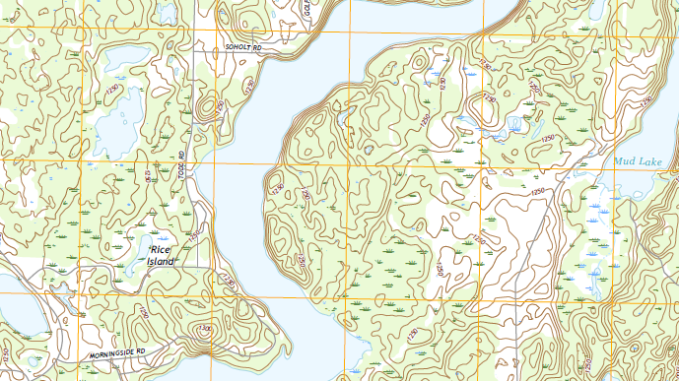


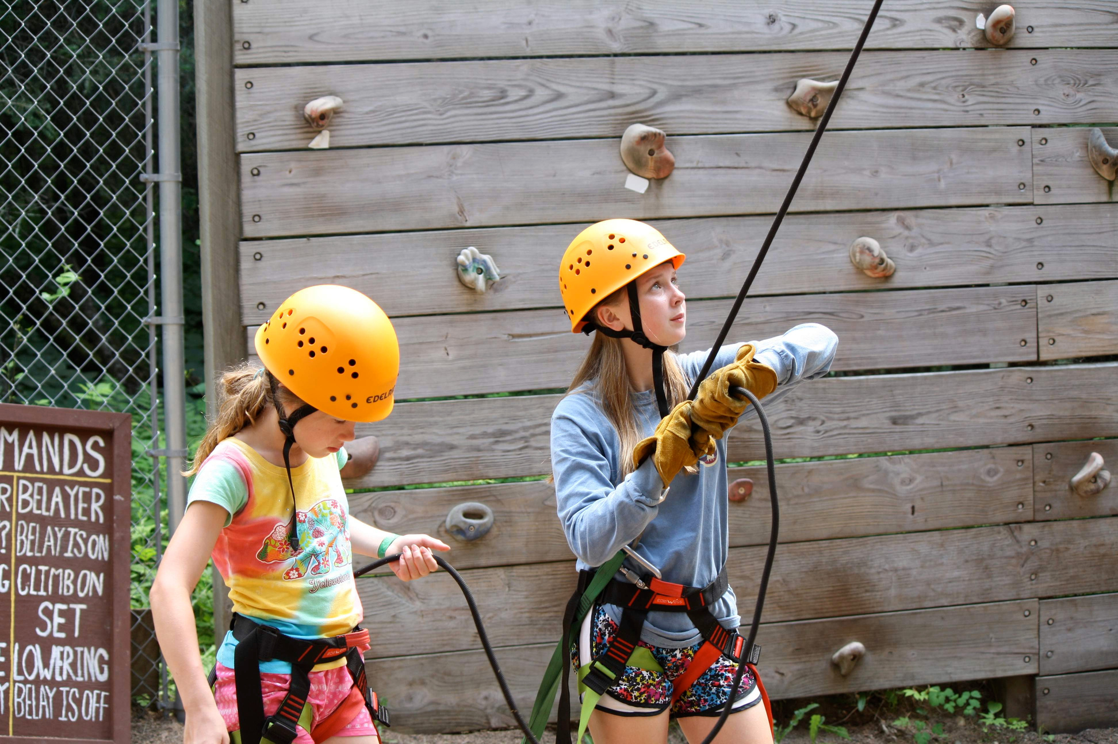
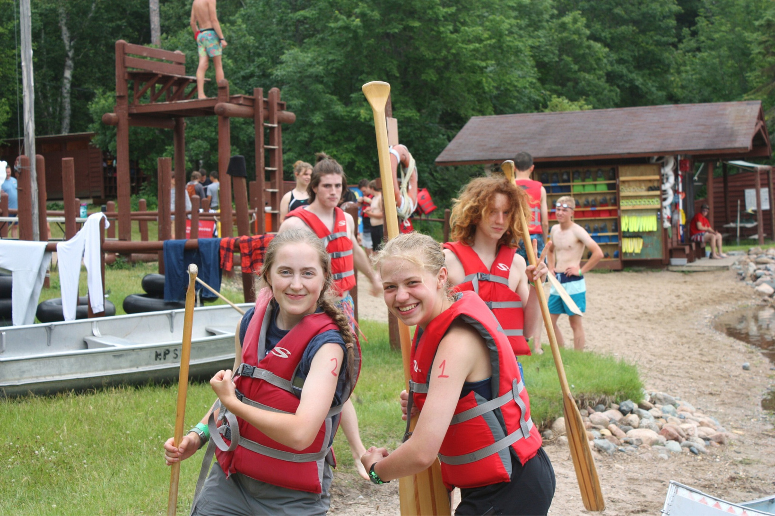
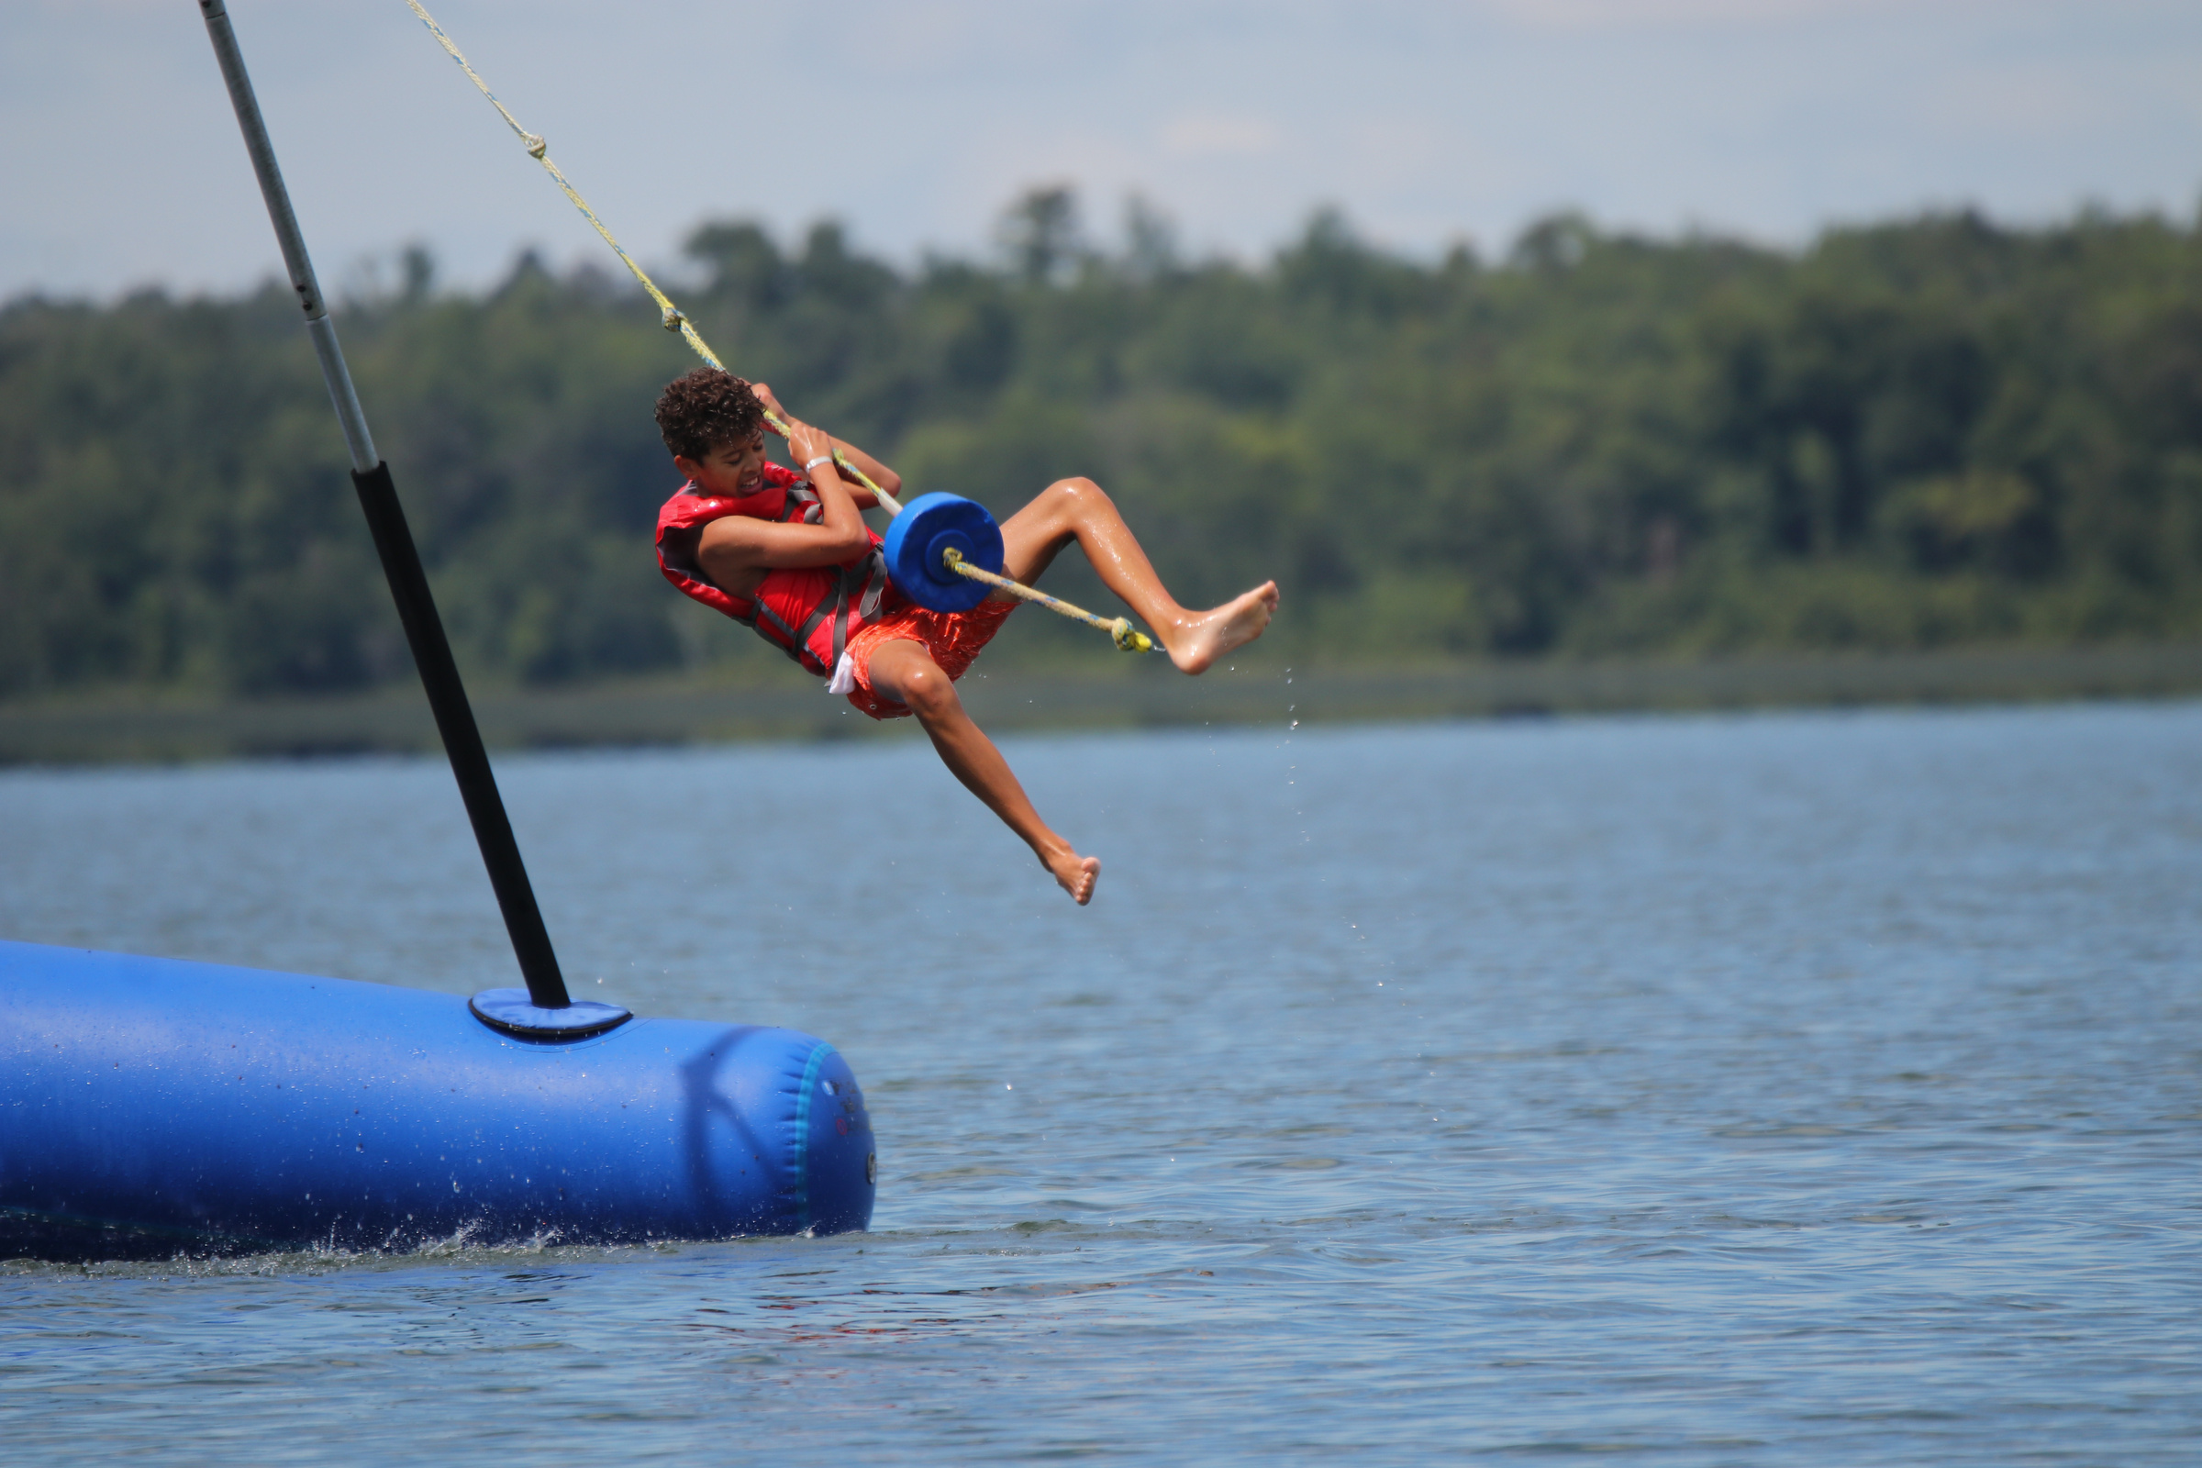
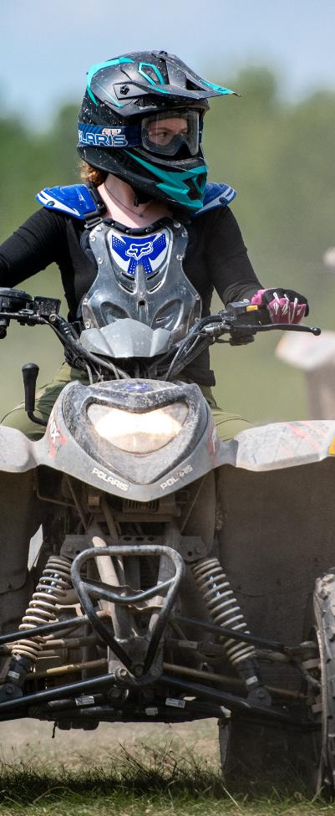
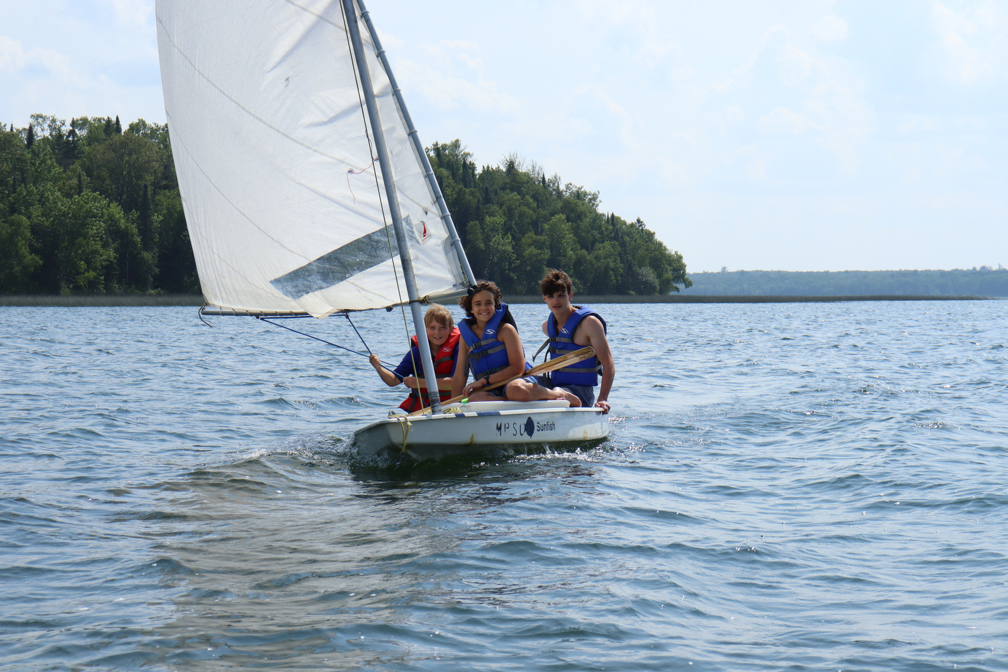
NORTHERN STAR SCOUTING
MANY POINT PROGRAM CATALOG
MANY POINT
SCOUT CAMP

Slide 2

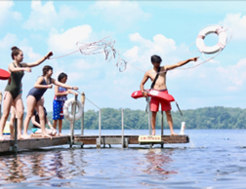
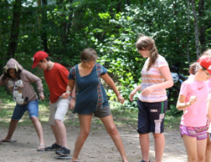
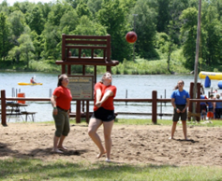
NORTHERN STAR SCOUTING
MANY POINT
A BALANCED PROGRAM
SCOUT CAMP
ADVANCEMENT TIME
SCOUts will focus on merit badges and advancement during the morning hours.
UNIT ACTIVITIES
UNIT ACtivities will be the focus of the afternoon; troops will participate in three hours of program. These will be scheduled with your commissioner.
FREE TIME
AFTER Dinner, all areas of camp are open. Scouts should buddy up and head to their favorite areas for some fun!

Slide 3
NORTHERN STAR SCOUTING
MANY POINT
A BALANCED PROGRAM
SCOUT CAMP
 | SUN | MON | TUE | WED | THURS | FRI | SAT
6:45 AM | Travel to Many Point |  | Polar Bear Swim
7:30 AM | Travel to Many Point | Breakfast | Breakfast | Breakfast | Breakfast | Breakfast | Breakfast
8:15 AM | Travel to Many Point | Assembly | Assembly | Assembly | Assembly | Assembly | Check Out
8:30 AM | Travel to Many Point | MB Session 1 | MB Session 1 | MB Session 1 | MB Session 1 | MB Session 1 | Check Out
9:30 AM | Travel to Many Point | MB Session 2 | MB Session 2 | MB Session 2 | MB Session 2 | MB Session 2 | Check Out
10:30 AM | Travel to Many Point | MB Session 3 | MB Session 3 | MB Session 3 | MB Session 3 | MB Session 3 | Travel Home
11:30 AM | Travel to Many Point | MB Session 4 | MB Session 4 | MB Session 4 | MB Session 4 | MB Session 4 | Travel Home
12:30 PM | Travel to Many Point | Lunch | Lunch | Lunch | Lunch | Lunch | Travel Home
1:00 PM | Check in, Swim Qualifications, Campsite Setup | Lunch | Lunch | Lunch | Lunch | Lunch | Travel Home
2:00 PM | Check in, Swim Qualifications, Campsite Setup | Unit Activity | Unit Activity | Unit Activity | Unit Activity | Unit Activity | Travel Home
3:00 PM | Check in, Swim Qualifications, Campsite Setup | Unit Activity | Unit Activity | Unit Activity | Unit Activity | Unit Activity | Travel Home
4:00 PM | Check in, Swim Qualifications, Campsite Setup | Unit Activity | Unit Activity | Unit Activity | Iron Scout | Unit Activity | Travel Home
5:00 PM | Check in, Swim Qualifications, Campsite Setup | Campsite Troop Time | Campsite Troop Time | Campsite Troop Time | Campsite Troop Time | Campsite Troop Time | Travel Home
6:00 PM | Dinner | Dinner | Dinner | Dinner | Dinner | Dinner | Travel Home
7:00 PM—9:00 PM | Camp Tours, Free Time, SM Meeting | Free Time | Free Time | Free Time | Free Time | Free Time | Travel Home
9:00 PM | Opening Campfire |  |  |  |  | Closing Campfire | Travel Home

Slide 4
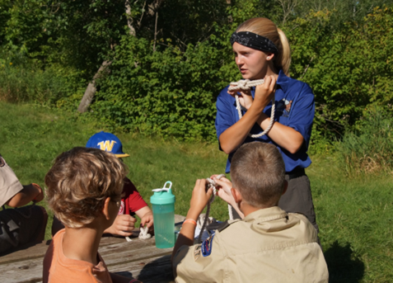
NORTHERN STAR SCOUTING
FIRST CLASS ADVENTURE & AQUATICS
MANY POINT
SCOUT CAMP
A FUN SKILL FOCUSED PROGRAM!
THE First Class Adventure program is an outdoor advancement program that focuses on Tenderfoot, Second Class and First Class requirements that can be done in a camp setting. Scouts will work with Many Point's engaging staff to become experienced at Scouting skills. After witnessing the Scout's advancement, unit leaders and Troop Guides can mark the advancement complete!
OTHER INFO
First Class Adventure Hike: On Wednesday evening Scouts will have the opportunity to complete their five-mile hike requirement
Scouts will also have the opportunity to earn Totin’ Chip and Firem’n Chit during the sessions
Many Point recommends that scouts who attend First Class Adventure either take Leatherwork & Textiles or Fish and Wildlife Management & Mammal Study during session 3. Both of these offerings are good introductory classes to Merit Badges at Many Point.
REQUIREMENTS COVERED IN FIRST CLASS ADVENTURE
SCout Rank: 1e, 4ab, 5
Tenderfoot Rank: 1ac, 3d, 4b, 5abc, 7a, 8
Second Class Rank: 1b, 2abcdfg, 3abcd, 4, 8a
First Class Rank: 1b, 3abcd 4b, 5a
ADULT LEADER SUPPORT
AT least one leader from each unit with Scouts enrolled in the First Class Adventure program MUST attend alongside the Scouts to help with instruction, organization, and skill testing.
REQUIREMENTS COVERED IN FIRST CLASS AQUATICS
SECond Class Rank: 5abcd
First Class Rank: 5bcd, 6abcde

Slide 5
NORTHERN STAR SCOUTING
UNIT ACTIVITIES
MANY POINT
SCOUT CAMP
WHAT IS A UNIT ACTIVITY?
MANY POINt was the first camp built and designed for unit development, and in staying true to our mission, we have structured program hours just for your unit!
Each afternoon, your unit will do three hours of activities together.
For program descriptions, please visit manypoint.org/program
HOW DO I SIGN UP?
Step 1: At a unit meeting, Scouts review available activities.
Step 2: Have your Patrol Leaders work with their patrol to determine which unit activities they’d like to do during their camp week.
Step 3: Have the Patrol Leaders Council meet and determine your unit’s top 15-20 programs to do at Many Point.
Step 4: The Unit camping coordinator can go to the Unit Activities page and can enter the units preferences into the “Unit Activity Interest” form.
Once your preferences have been submitted, camp staff will review all the requests from your unit and build your schedule. Your schedule will be given to you at camp by your commissioner.

Slide 6
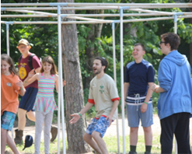
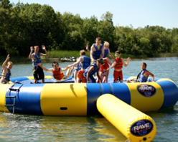
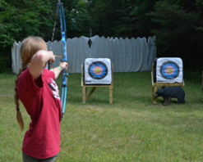
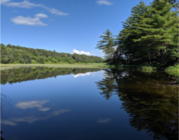
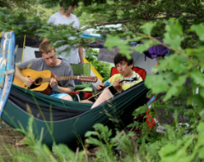
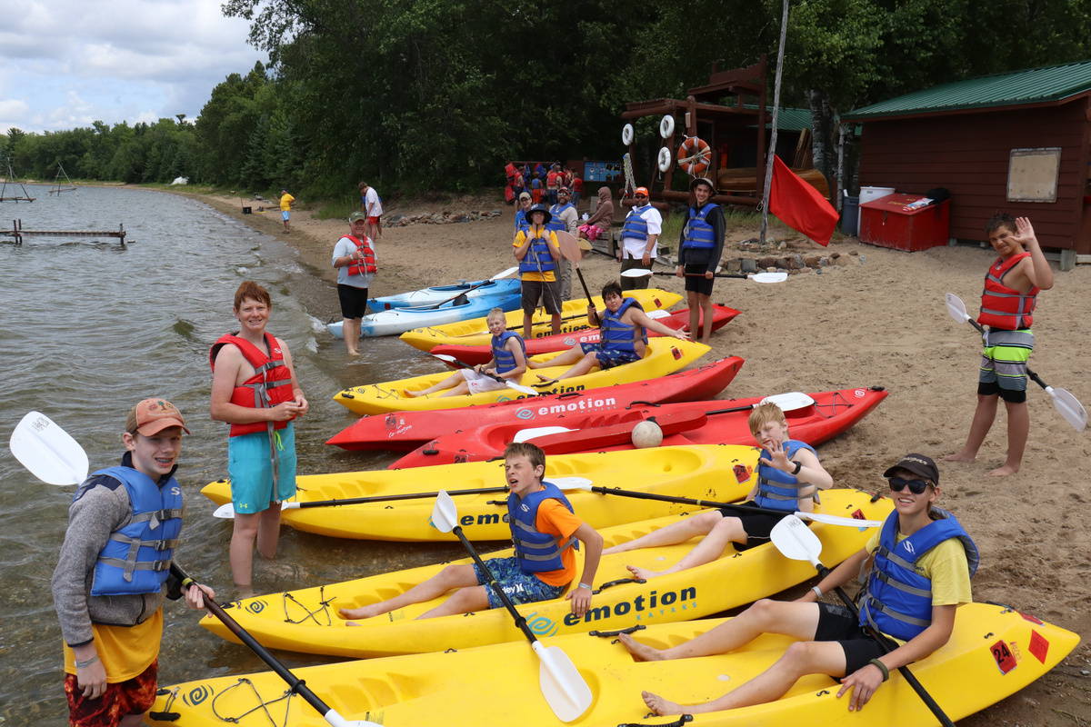
NORTHERN STAR SCOUTING
UNIT ACTIVITIES
MANY POINT
SCOUT CAMP
ARCHERY, TOMAHAWKS & SLINGSHOTS
9 SQUARE
AQUA TRAMPOLINE
CANOEING/KAYAKING/ ROWING
BACK OF THE MOON HIKE
CAMPSITE FREE TIME

Slide 7
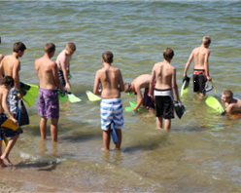
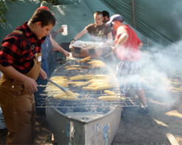
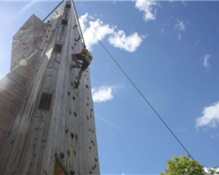
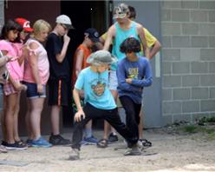
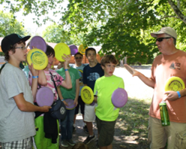
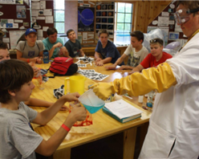
NORTHERN STAR SCOUTING
UNIT ACTIVITIES
MANY POINT
SCOUT CAMP
CANOE SNORKEL
CHOPPED!
CLIMBING TOWER
DELTA
DISC GOLF
DR. DNA

Slide 8
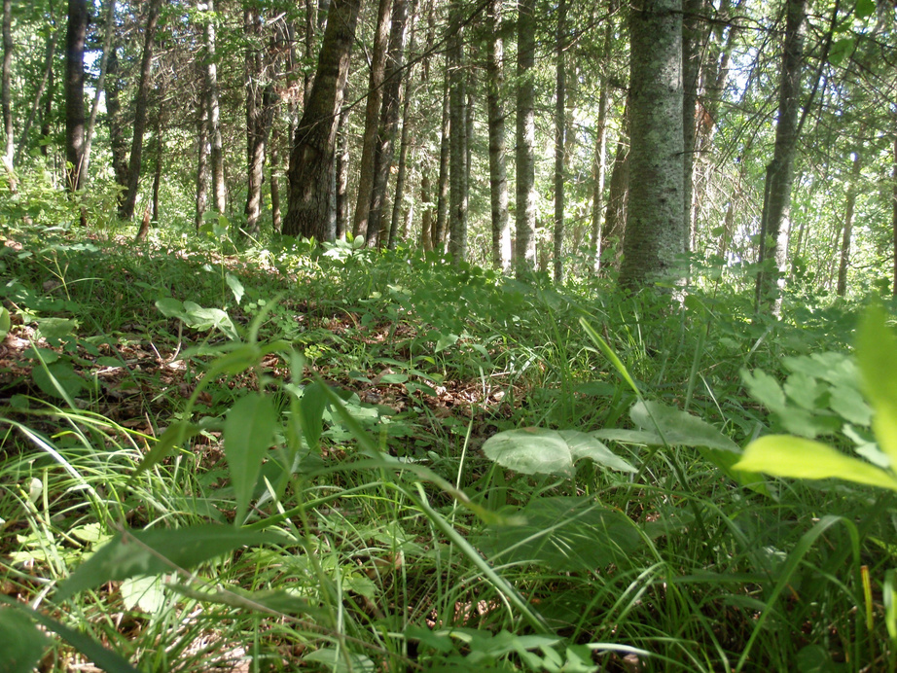
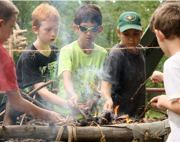
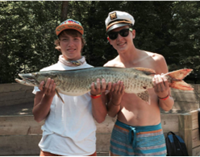
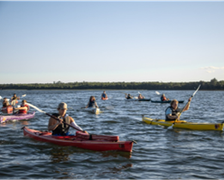
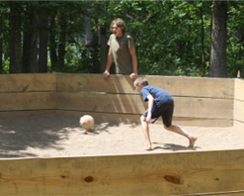
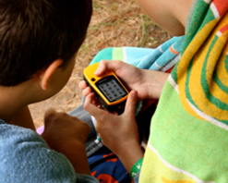
NORTHERN STAR SCOUTING
UNIT ACTIVITIES
MANY POINT
SCOUT CAMP
FIREM’N CHIT & TOTIN’ CHIP
FISHING
ECOSYSTEM IN A JAR
FLOAT FOR FLOATS
GAGA BALL
GPS & GEOCACHING

Slide 9
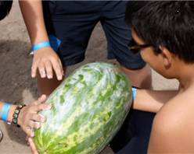
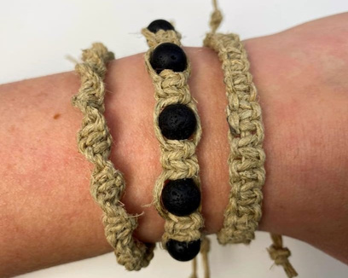
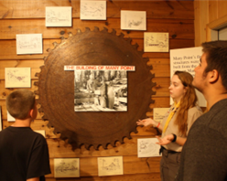
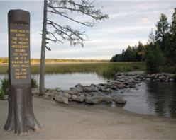
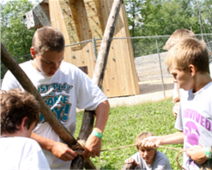
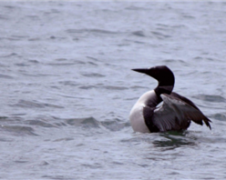
NORTHERN STAR SCOUTING
UNIT ACTIVITIES
MANY POINT
SCOUT CAMP
HISTORY CENTER/
FIRE TOWER
GREASED WATERMELON
HEMP CRAFT
ITASCA STATE PARK
KNOTS & LASHINGS
LOON LORE

Slide 10
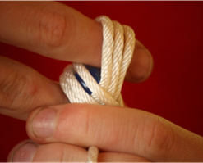
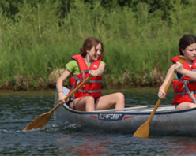
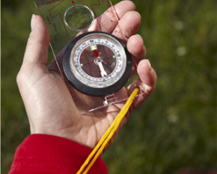
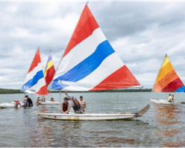
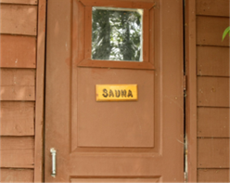
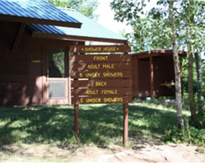
NORTHERN STAR SCOUTING
UNIT ACTIVITIES
MANY POINT
SCOUT CAMP
MONKEY’S FIST
TURK’S HEAD
NATURE CANOE/KAYAK
ORIENTEERING
SAILING
SAUNA
SHOWERHOUSE TIME

Slide 11
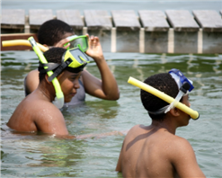
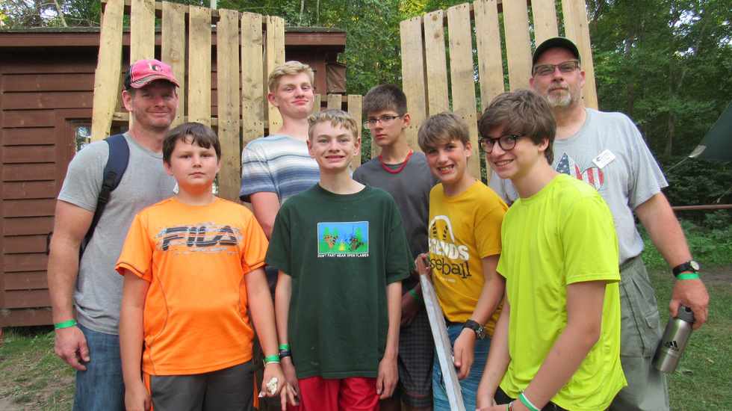
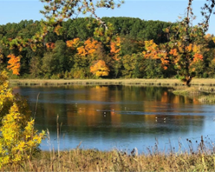
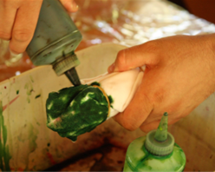
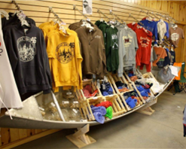
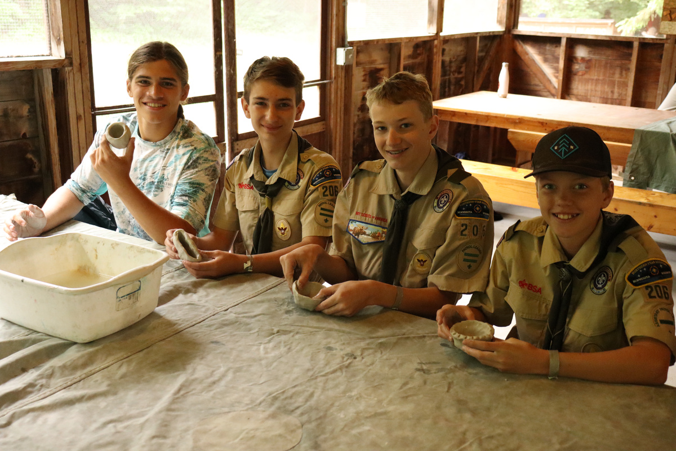
NORTHERN STAR SCOUTING
UNIT ACTIVITIES
MANY POINT
SCOUT CAMP
TAMARAC WILDLIFE REFUGE
SNORKELING
SUPER TROOP PROJECT
TIE DYE
TRADING POST TIME
TROOP POTTERY

Slide 12
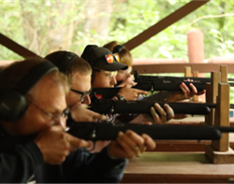
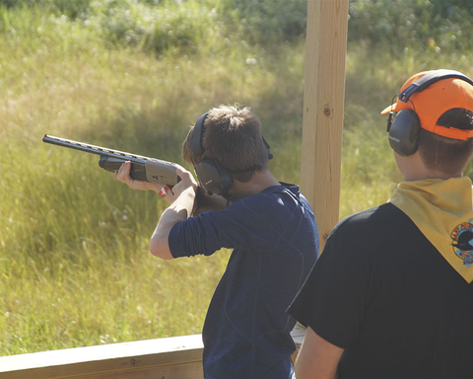
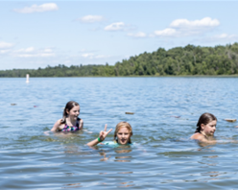
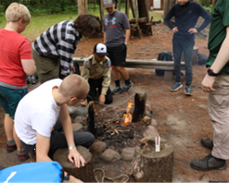


NORTHERN STAR SCOUTING
UNIT ACTIVITIES
MANY POINT
SCOUT CAMP
TROOP RIFLE
TROOP SHOTGUN
TROOP SWIM
ULTIMATE SURVIVOR
WATER POLO
WHAT’S COOKING?

Slide 13





NORTHERN STAR SCOUTING
OLDER SCOUT PROGRAMS - 5-STAND
MANY POINT
SCOUT CAMP
A next-level shotgun challenge for more experienced Scouts. Put your sharpshooting skills to the test by tackling our unique set of 5 difficult stations.
$35 per Scout
Offered Mon, Tues, Thurs, Fri
Must be at least 13 by 8/31/26

Slide 14


NORTHERN STAR SCOUTING
OLDER SCOUT PROGRAMS - ATV
MANY POINT
SCOUT CAMP
ATV SAFETY TRAINING
MASTER THE BASICS, LEARN ADVANCED MANEUVERS, THEN CONQUER THE WILD! THIS PROGRAM IS ALL ABOUT YOUR SKILLS AND DECISIONS - WHICH TO STRENGTHEN AND WHICH TO FORGET.
SCOUTS MUST COMPLETE THE ASI ONLINE TRAINING BEFORE COMING TO CAMP.
$45 per Scout
Offered Mon – Fri
Must be at least 14 years old
ATV TRAIL RIDE
SPEND THE EVENING FROM 7PM-9PM RIDING THE TRAILS ON OUR EXTENDED TRAIL RIDE AFTER A QUICK REFRESHER ON HOW TO DRIVE THE ATV.
SCOUTS MUST HAVE PREVIOUSLY COMPLETED THE FULL ASI certification COURSE AND PROVIDE THEIR CERTIFICATION CARD TO PARTICIPATE.
$25 PER SCOUT
OFFERED TUES, WED, THURS
MUST BE AT LEAST 14 YEARS OLD

Slide 15


OLDER SCOUT PROGRAMS - BIG BOAT SAILING
NORTHERN STAR SCOUTING
MANY POINT
SCOUT CAMP
Set sail and explore Many Point Lake. Scouts will learn how to set up and sail these boats with the help of our staff members.
Offered Mon, Wed, Fri
Must be at least 13 by 8/31/26

Slide 16





NORTHERN STAR SCOUTING
OLDER SCOUT PROGRAMS - BIKE TREK
MANY POINT
SCOUT CAMP
Start on our mountain bike challenge course and then move on to exploring trails. The forested trails at Many Point are a summer haven for mountain biking enthusiasts with some technical stretches of trail that will test even the most experienced cyclists.
Offered Tues, Thurs, Fri
Must be at least 13 by 8/31/26

Slide 17




OLDER SCOUT PROGRAMS - CHARACTER ADVENTURE CHALLENGE
NORTHERN STAR SCOUTING
MANY POINT
SCOUT CAMP
The Character Adventure Challenge is a half-day program located off-site where Scouts will learn teamwork and have the opportunity to work together to complete many high ropes course activities.
$60 per Scout
Offered Wed only
Must be at least 12 years old

Slide 18





OLDER SCOUT PROGRAMS - FISHING OUTPOST OVERNIGHT
NORTHERN STAR SCOUTING
MANY POINT
SCOUT CAMP
Explore the world of fishing on Many Point Lake during the Fishing Outpost Overnight. Experienced guides will teach you the basics and more advanced angling techniques to help you explore the wonders of Many Point Lake.
Offered Tues, Wed, Thurs
Must be at least 13 by 8/31/26

Slide 19





OLDER SCOUT PROGRAMS - HUCK FINN OVERNIGHT
NORTHERN STAR SCOUTING
MANY POINT
SCOUT CAMP
Swimming, jumping, fishing, cooking, snorkeling, competing in contests, playing capture the flag by canoe, and more, all from our 40ft by 40ft rafts in Flintlock Bay. Do some incredible stargazing from the middle of Many Point Lake.
Offered Mon, Tues, Thurs
Must be at least 13 by 8/31/26

Slide 20


OLDER SCOUT PROGRAMS - TREEHOUSE OVERNIGHT
NORTHERN STAR SCOUTING
MANY POINT
SCOUT CAMP
As seen in Scouting Magazine, Scouts will spend the evening in one of two villages hovering in the trees above a 30ft bluff.
Activities include cooking, spar pole climbing, yard games, and our new and improved throwables range.
Offered Mon, Tues, Wed
Must be at least 13 by 8/31/26

Slide 21



OLDER SCOUT PROGRAMS - WATER SKIING
NORTHERN STAR SCOUTING
MANY POINT
SCOUT CAMP
Slalom and jump waves as you waterski around Many Point Lake behind one of our camp speedboats. This adventure is for both new and experienced water skiers.
$15 per Scout
Offered Tues, Wed, Thurs
Must be at least 13 by 8/31/26

Slide 22





OLDER SCOUT PROGRAMS - ALL THINGS SCUBA
NORTHERN STAR SCOUTING
MANY POINT
SCOUT CAMP
Scouts can earn their PADI
certification, Scuba BSA, and Scuba MB.
Only offered July 5th-11th.
$500 per Scout (in addition to the normal camp fee)
Must be at least 14 years old

Slide 23




OLDER SCOUT PROGRAMS - MOUNTAIN BIKE OUTPOST
NORTHERN STAR SCOUTING
MANY POINT
SCOUT CAMP
Scouts will spend every morning learning all about mountain biking! They’ll have lots of time to improve their technique on our very own challenge course and will complete several rides around Many Point. This outpost will also give Scouts a chance to complete some of the requirements for the Cycling merit badge.
$30 per Scout
Must be at least 14 by 8/31/26

Slide 24





OLDER SCOUT PROGRAMS - OLDER SCOUT ADVENTURE BLAST
NORTHERN STAR SCOUTING
MANY POINT
SCOUT CAMP
Replace traditional morning activities with wild adventures all week long! With this all-encompassing program, Scouts will be able to experience older scout activities without missing afternoon time with their troop.
$60 per Scout
Must be at least 14 years old

Slide 25




OLDER SCOUT PROGRAMS - ROBOTICS OUTPOST
NORTHERN STAR SCOUTING
MANY POINT
SCOUT CAMP
Earning the Robotics merit badge requires a Scout to understand how robots move (actuators), sense the environment (sensors), and understand what to do (programming). Throughout the week, Scouts will build a robot as a team to compete on Friday against other teams in this year’s robotics challenge.
$30 per Scout
Must be at least 12 by 8/31/26

Slide 26





OLDER SCOUT PROGRAMS - WATER SPORTS OUTPOST
NORTHERN STAR SCOUTING
MANY POINT
SCOUT CAMP
Scouts will spend mornings all week jet skiing, water skiing, kayaking, and motorboating on Many Point Lake. Scouts will go through safety training and earn Motorboating merit badge.
$60 per Scout
Must be at least 14 years old

Slide 27
OLDER SCOUT PROGRAMS - WATER SPORTS OUTPOST
NORTHERN STAR SCOUTING
MANY POINT
SCOUT CAMP
Scouts will spend mornings all week jet skiing, water skiing, kayaking, and motorboating on Many Point Lake. Scouts will go through safety training and earn Motorboating merit badge.
$60 per Scout
Must be at least 14 years old

Slide 28

NORTHERN STAR SCOUTING
CUSTOM T-SHIRTS
MANY POINT
SCOUT CAMP
Ordering Deadlines
· Order by May 10th to get your shirts by June 11th
· Order by June 7th to get your shirts by July 9th

Slide 29


NORTHERN STAR SCOUTING
FOOD SERVICE
MANY POINT
SCOUT CAMP

Slide 30

NORTHERN STAR SCOUTING
FAMILY CAMP
MANY POINT
SCOUT CAMP

Slide 31


NORTHERN STAR SCOUTING
FAMILY CAMP
MANY POINT
SCOUT CAMP
MANY POINT’S HIDDEN GEM!!
FAMILY CAMP IS A FUN-FILLED, AFFORDABLE VACATION DESTINATION FOR ALL FAMILIES! AT OUR FAMILY CAMP, WE OFFER PROGRAMS AND FACILITIES FOR FAMILIES SO THAT YOU CAN SEE WHAT YOUR SCOUTS ARE ENJOYING HERE AT MANY POINT SCOUT CAMP. WE OFFER CABINS FOR RENT, WONDERFUL TENT CAMPING SITES, AND A RECREATIONAL VEHICLE AREA.
REServations are available, and WE ENCOURAGE ALL SCOUT FAMILIES TO COME AND ENJOY A WEEK AT MANY POINT.
GO TO MANYPOINT.ORG/FAMILY-CAMP to learn more about Family Camp and book a cabin, RV, or tent site.
COST
All spaces require a $100 deposit due at the time of
booking.
Cabin - $465
RV Site - $215
Tent Site - $165
WHO CAN COME TO FAMILY CAMP?
FAMILY CAMP IS OPEN TO ALL SCOUT FAMILIES AND NON-SCOUT
FAMILIES! ALL AGES ARE WELCOME!

Slide 32

NORTHERN STAR SCOUTING
WORK PARTY MAY 29-31
MANY POINT
SCOUT CAMP

Slide 33

NORTHERN STAR SCOUTING
REQUESTING EQUIPMENT
MANY POINT
SCOUT CAMP
Nylon Tents $10
Canvas Tents $8
Cot $3
Tarp $4
Propane $30 per tank
LP stove $40

Slide 34
NORTHERN STAR SCOUTING
CAMP FEES
MANY POINT
SCOUT CAMP
Participant Fees
Youth Fee: $415
Adult Full Week $150
Adult Partial Week
· Sunday $17
· Monday-Friday $29/day
· Saturday $7
Bringing your own food?
Troops/Scouts bringing their own food pay $45 less per person.
PAYMENT TIMELINE
Upon Reservation:
$100 non-refundable campsite deposit
April—Before Program Sign Up
$50 deposit (non-refundable) per Scout. The deposit is required before you can sign a Scout for any individual programs. These are due on or before April 15th.
June 1st: Full camper fee payment is due on June 1st, prior to camp.
End of week at camp: Any incidentals fees (patch sales, charges to trading post, troop program charges) accumulated at camp will be due upon checkout.

Slide 35

NORTHERN STAR SCOUTING
CAMP FEES
MANY POINT
SCOUT CAMP
FINANCIAL ASSISTANCE
For Scouts who are not able to afford the full fee of camp, there is financial support available. This assistance is like a scholarship for camp. We call these camperships. The funds to provide camperships are supplied by donors in Northern Star Council and are ear-marked for Northern Star Scouts only.
To apply, go online or scan the QR Code. Applications due by June 1st.
Discount for camping twice
Scouts that attend Tomahawk or Many Point twice in a summer will receive $50 off their second week.

Slide 36




Slide 37




Slide 38


Slide 39


Slide 40


Slide 41
NORTHERN STAR SCOUTING
MANY POINT
SCOUT CAMP
QUESTIONS?

